Slide 1
The Bold, the Strong, and the Bang!
Team: La Baristas
Data Boot Camp
March 30, 2019

Slide 2
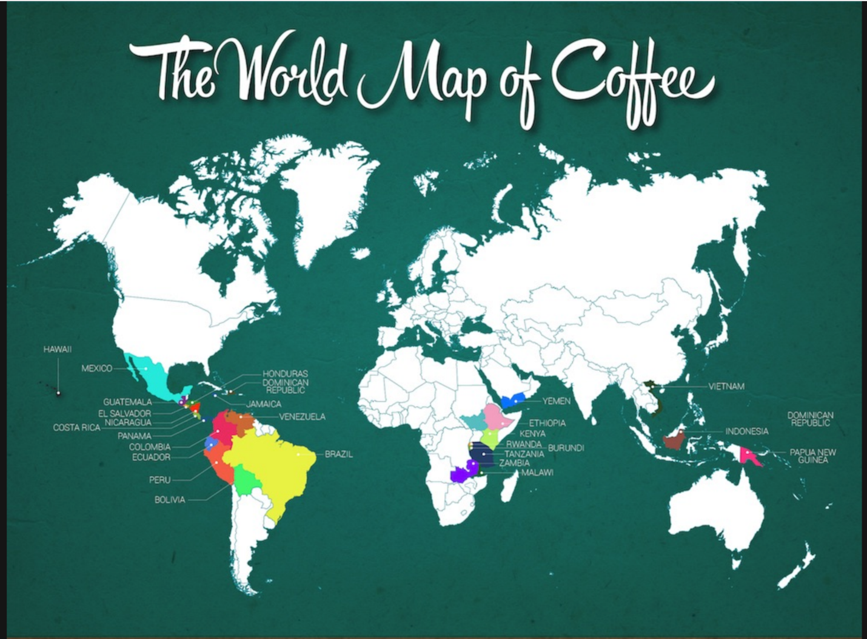
COFFEE AROUND THE WORLD

Slide 3
Over 2.2 billion cups of coffee are consumed world wide every day.

Slide 4
A $20 Billion Dollar Industry (in the US alone)!
Have you every thought much about the coffee or tea you choose to drink?
What comes first to mind in making your choice, flavor, caffeine level, brand, or price?
Have you ever thought of the health benefits or lack of?
What if you could evaluate your choice of drink at the click of a button and know exactly what you were getting for your price, how valuable would that be?
Well now you can!

Slide 5
The Bold, The Strong, and The Bang!
La Baristas introduces the Bold, the Strong, and the Bang!
The purpose of this project is to provide users with an interactive website that provides detailed information about the coffee of their choice at their fingertips
We show the quality of the top coffee beans in a visual and interactive manner
Here’s how:

Slide 6
Our Approach
We started with trying to research the top name brand coffees and teas
Scrape various website for the following parameters:
  Rank
  Harvest Location
  Manufacturing Process
  Health Claims
  Average Price
  Consumer Reviews
  Brewing Process
  Caffeine Level

Slide 7
SAMPLE WEBSITES to SCAPE
COFFEE:
https://topbestbrands.com/top-best-coffee-brands/
https://www.thecoffeemaven.com/best-instant-coffee/
http://coffeeinmyveins.com/world-map-coffee/
TEAS
https://topbestbrands.com/best-tea-brands/
http://www.thedailyrecords.com/2018-2019-2020-2021/world-famous-top-10-list/highest-selling-brands-products-companies-reviews/best-green-tea-brands-india-high-quality-weight-loss/10074/
https://www.envisioninteligence.com/blog/top-tea-brands-in-world/

Slide 8
CHANGES in our APPROACH
We quickly learned that trying to do Coffee and Tea was a bit ambushes
Focusing on coffee brands alones was overwhelming
Had to narrow our approach to just coffee and decided to focus on the types of coffee beans

Slide 9
Coding Approach Continued
First we researched the different types of coffee beans and scraped the web for details
Next we attempted to deploy our data to a database: MySQL and AWS.
We were able to connect to the database but had trouble reading in the file
We then move on to displaying the results in visualizations that allow the user to change views and enter their own parameters for more detailed information
CODE and VIEWS
Notes:
We will use Leaflet, MATPLOTLIB, and PLOTLY to create:
Interactive Geographical Map of Harvest Locations
Detailed categories of manufacturing process
A visual map of the most expensive coffee and teas
Geographic view the most concentrated users in the world

Slide 10
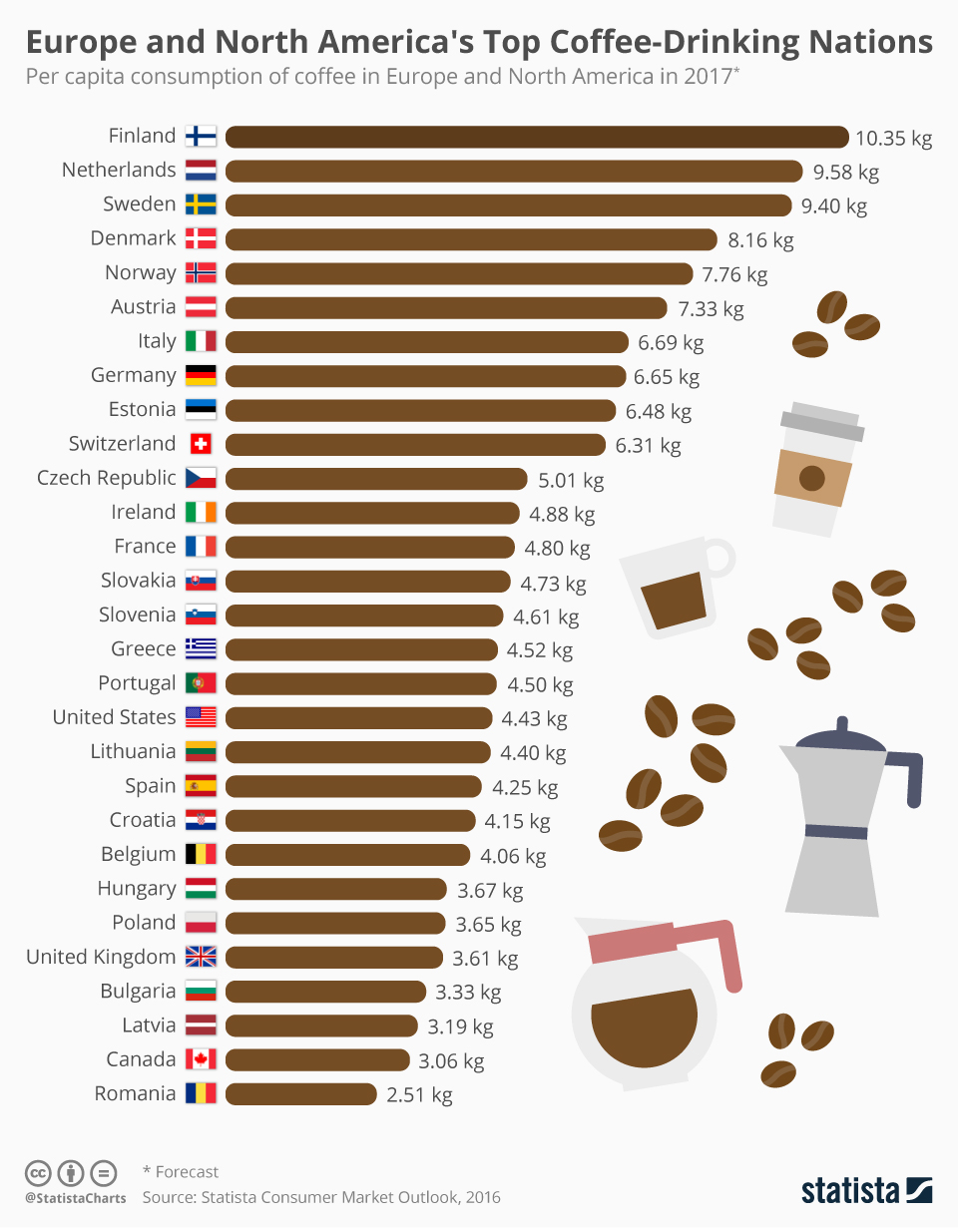
GRAPHS

Slide 11
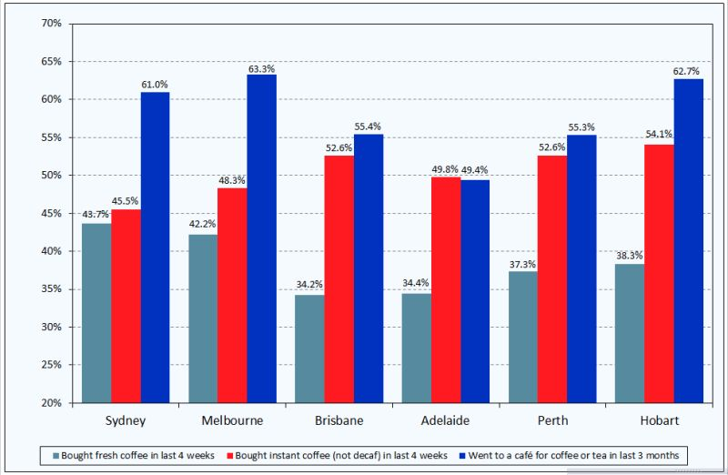

Slide 12
Project #2: Visualize Me Captain!
Week 18
REQUIREMENTS |
Data Boot Camp 2019

Slide 13
Project Description
For this third project, your task will be to "tell a story" through data visualizations.
Unlike the first project, where you focused on using the "Analytics Paradigm" to explore relationships in "report form", this project should be more focused on providing users an interactive means to explore data themselves.
Just as with the first project, you will be asked to conduct a 10 minute presentation that lays out your theme, coding approach, data munging techniques, and final visualization.
You may choose a project of any theme, but we encourage you to think broadly. The universe is wide and expansive. Don't limit yourself to what you know.
You will have roughly two weeks to complete this project. You will have ample time in class to work with your group (but expect to put in some long nights in the days ahead).

Slide 14
Specific Requirements
Your visualization must include a Python Flask powered RESTful API, HTML/CSS, JavaScript, and at least one CLOUD database (MySQL (on AWS) ,MongoDB (on AWS or M-Lab), or another CLOUD database)
Your project should fall into one of the below four tracks:
  A custom "creative" D3.js project (i.e. non-standard graph or chart)
  A combination of Web Scraping and Leaflet or Plotly
  A dashboard page with multiple charts all updating from the same data
  A "thick" server that performs multiple manipulations on data in a database prior to visualization
Your project should include at least one JS library that we did not cover.
Your project must be powered by a dataset with at least 100 records.
Your project must include some level of user-driven interaction (e.g. menus, dropdowns, textboxes, etc.)
Your final visualization should ideally include at least three views

Slide 15
Schedule
Notes:
It’s important to keep in mind why you joined this class. Let’s talk about your goals.

Slide 16
Weekly Schedule
Week 1:
You will need to start brainstorming topics with your group and researching potential datasets. Your focus should specifically center around:
  Selecting a Topic
  Finding a Dataset
  Finding Inspiration
  "Sketching" your ideal visuals
  Creating a 1-Page Proposal
Week 1:
You will need to create a 1 page proposal. The proposal should include:
  A brief articulation of your chosen topic and rationale
  A link to your dataset(s) and a screenshot of the metadata if it exists.
  3-4 screenshots of relevant "inspiring" visualizations that frame your creative fodder
  A sketch of the final design
  A link to the primary GitHub repository you'll be housing your work in
Weeks 1 and 2: Project Work and Refinement

Slide 17
FINDINGS & FUTURE ANALYSES
The overarching question we wanted to know was…”What determines the price of coffee, and are you getting the most BANG (caffeine) for your buck?”
What we’ve learned…..
There are hundreds, if not thousands, of variations of coffee blends and several types of coffee beans in various regions such as the Kona bean from Hawaii. However, almost all coffee comes from four types of beans: Arabica, Robusta, Liberica, and Excelsa; with Arabica and Robusta being the most popular beans. Almost every coffee is a blend of one or more of these four.

Slide 18
FINDINGS & FUTURE ANALYSES
The BANG (caffeine) and richness depends on the BEAN
The strength and wellness of the bean depends on the harvesting and processing time
The quality and taste depends on the whole bean or blend and brew time
However, the PRICE – which is what we were originally focused on - depends on the rarity of the bean and mostly “Hype”

Slide 19
FINDINGS & FUTURE ANALYSES
The Best Hype of All is Kopi Luwak or Civet Coffee. Which can sell for as high as $500.00 per ounce and made famous in the movie “The Bucket List” by Jack Nicholson.
Kopi Luwak is coffee that includes partially digested coffee cherries, or beans eaten and defecated by the Asian palm civet. Variations of Kopi Luwak include beans digested by other types of animals depending on geographic including birds, elephants, and squirrels.
In Vietnam, Kopi Luwak is digested by weasels.

Slide 20
FINDINGS & FUTURE ANALYSES
Future Analysts:
Compare the types of teas to prices
Compare hype with stock prices
A deeper comparative analysis between the most expensive brands and the cheapest brands
THANK YOU! Q & A

